Slide 1













Reviewer approves the article
Mark article for review
Publish article on portal
Reviewer picks the article for review
Mark the article for translation
Needs Review
In Review
Draft
Create an article
Update the article
Reviewer rejects the article
Article available to use

Slide 2


Reviewer approves the article
Mark article for review
Publish article on portal
Mark article for review
Needs Review
Reviewer picks the article for review
Mark the article for translation
In Review
Draft
Create an article
Update the article
Reviewer rejects the article
Article available to use

Slide 3
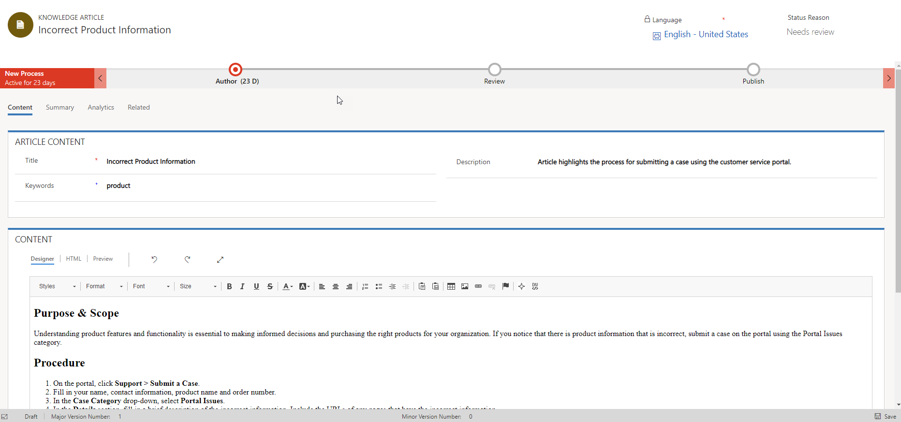
The description will be visible when the article is made available on a external facing portal.
Content can be created in Rich Text, or HTML.
Full WISIWIG editor provides embedding, images, flags and other items.

Slide 4
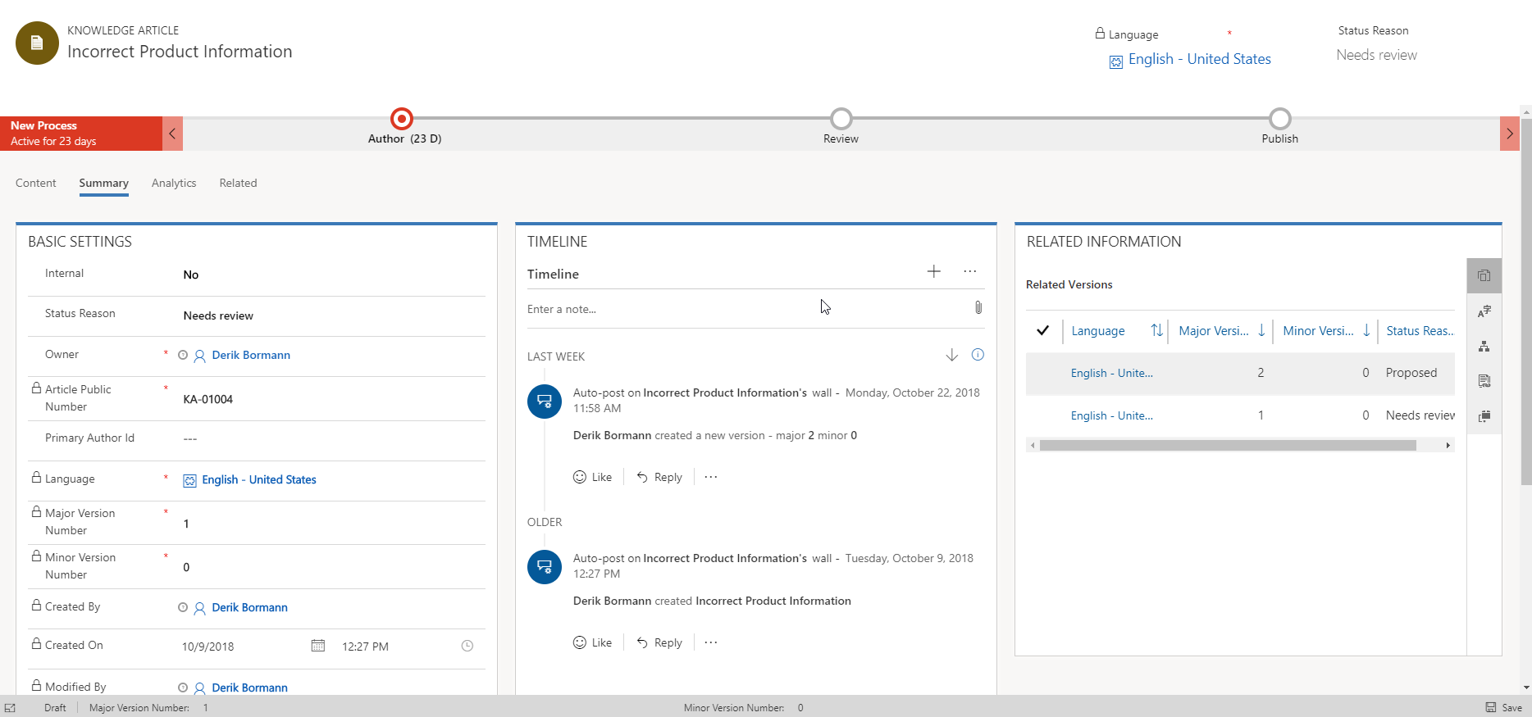
Icons make it easy to navigate to records related to the article such as versions, translations, and associated products.
Timeline displays activities related to the article

Slide 5
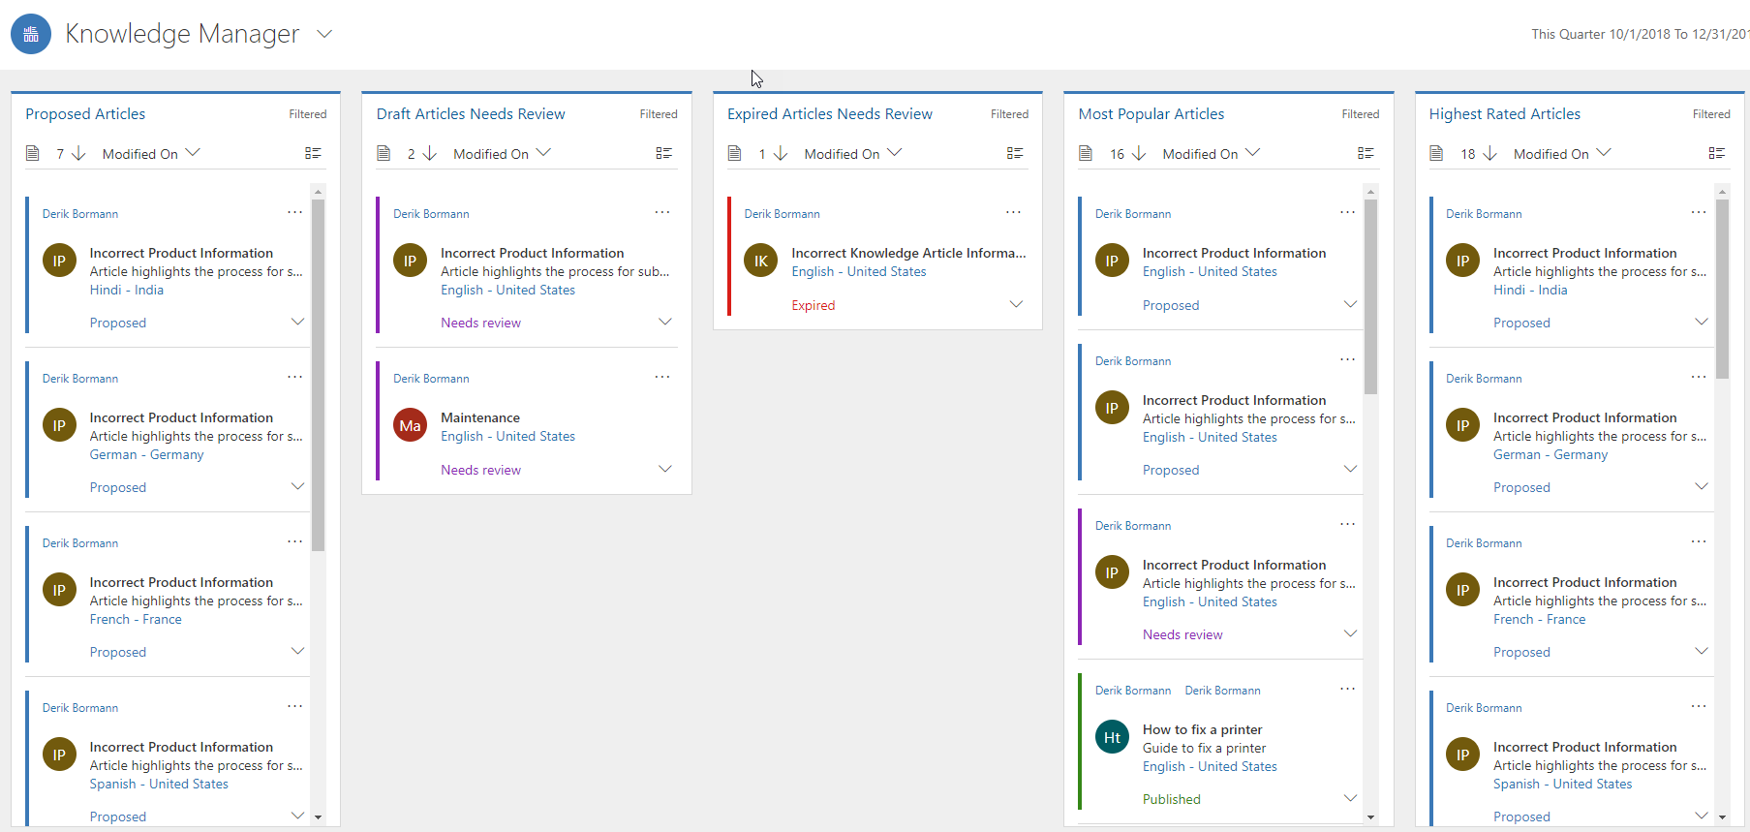
Displays articles that have been proposed, as well as articles that are in need of review.

Slide 6
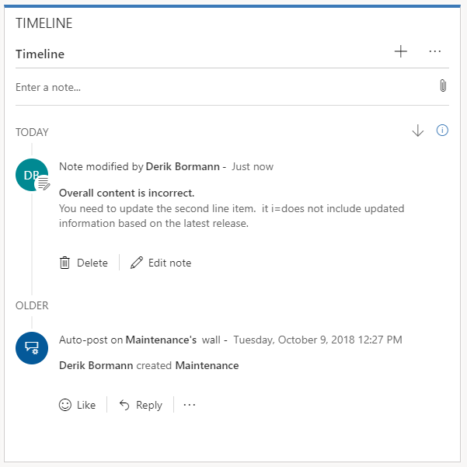
Notes can be added directly to the article’s Timeline.
Notes appear in the order that they were added to the article.

Slide 7
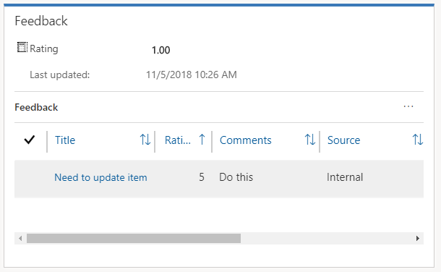
An articles feedback rating can be recalculated by selecting the calculator icon.

Slide 8
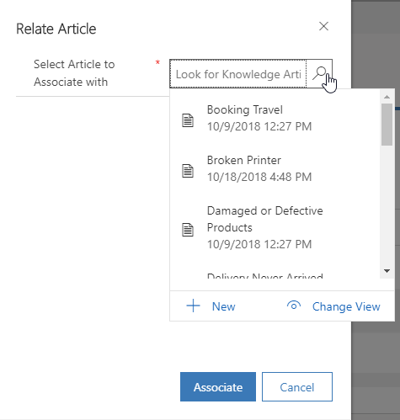

Slide 9
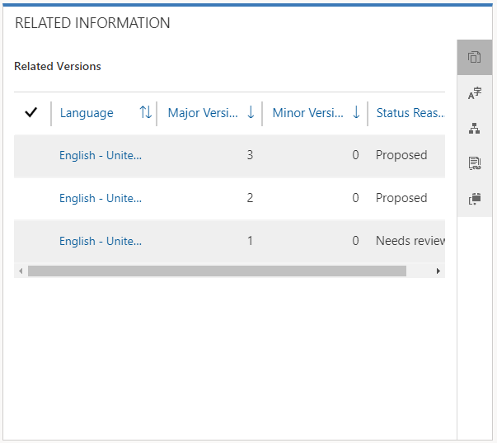

Slide 10
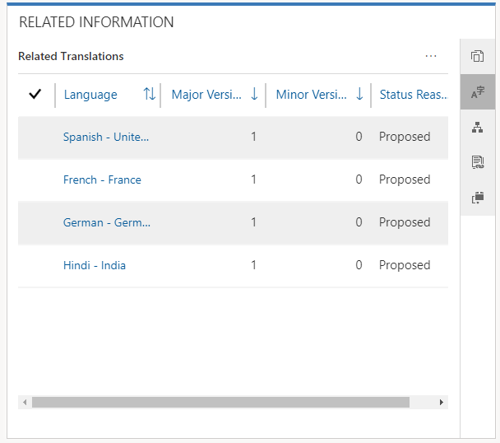

Slide 11
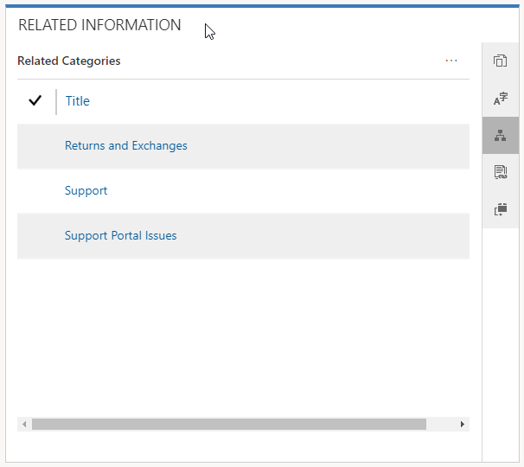

Slide 12
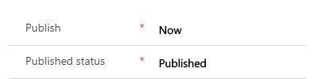
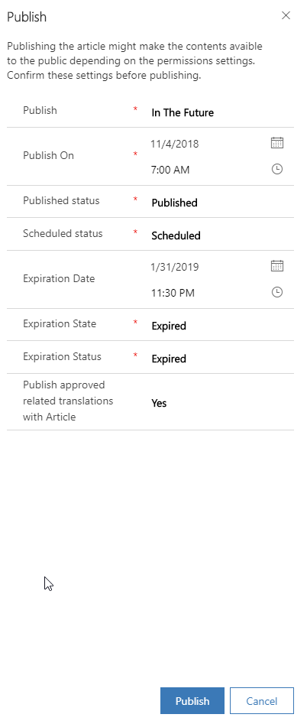
Immediate Publish
Scheduled Publish

Slide 13
Expiration Information

Slide 14
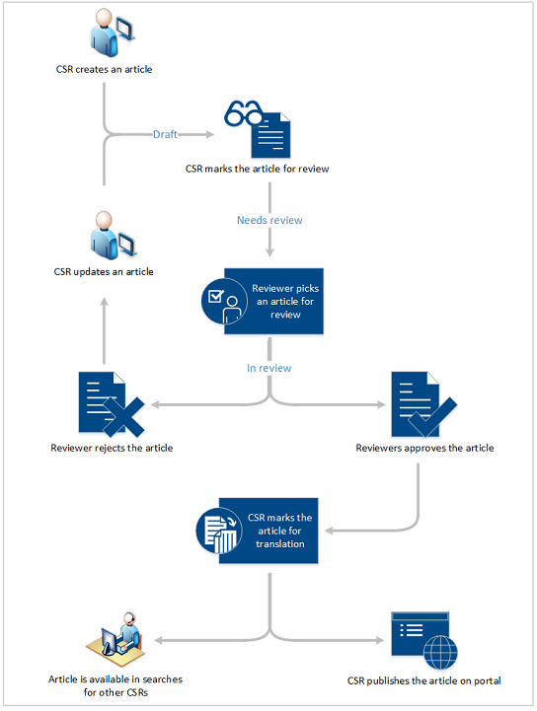
CSR creates an article
Article is available in searches
for other CSRs
Draft
CSR marks article for review
CSR marks the article for translation
Needs Review
CSR updates an article
Reviewer picks an article for review
CSR publishes the article to portal
In Review
Reviewer rejects the article
Reviewer approves the article

